Slide 1

Feature Flags
The Art of the IF and Deployment

Slide 2

Chris Ayers Senior Customer Engineer Microsoft
Twitter: @Chris_L_Ayers
linkedin.com/in/chris-l-ayers/
Blog: https://chrislayers.com/
GitHub: https://github.com/codebytes

Slide 3

Agenda
What are Feature Flags?
Why use Feature Flags?
Operationalizing Flags
Deployment vs Release

Slide 4
What Are Feature Flags?

Slide 5
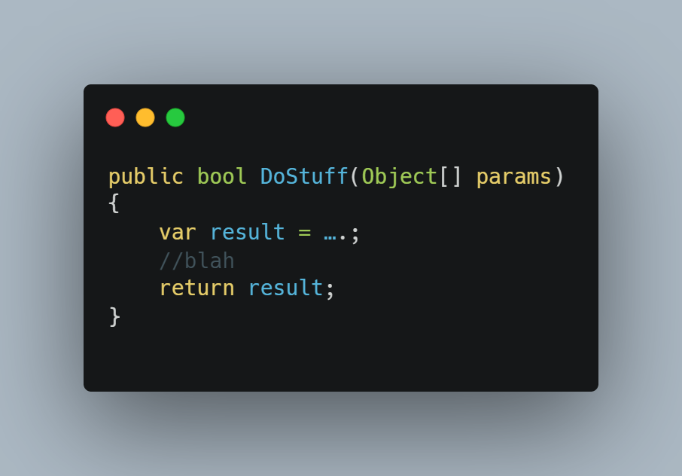
Original Code

Slide 6
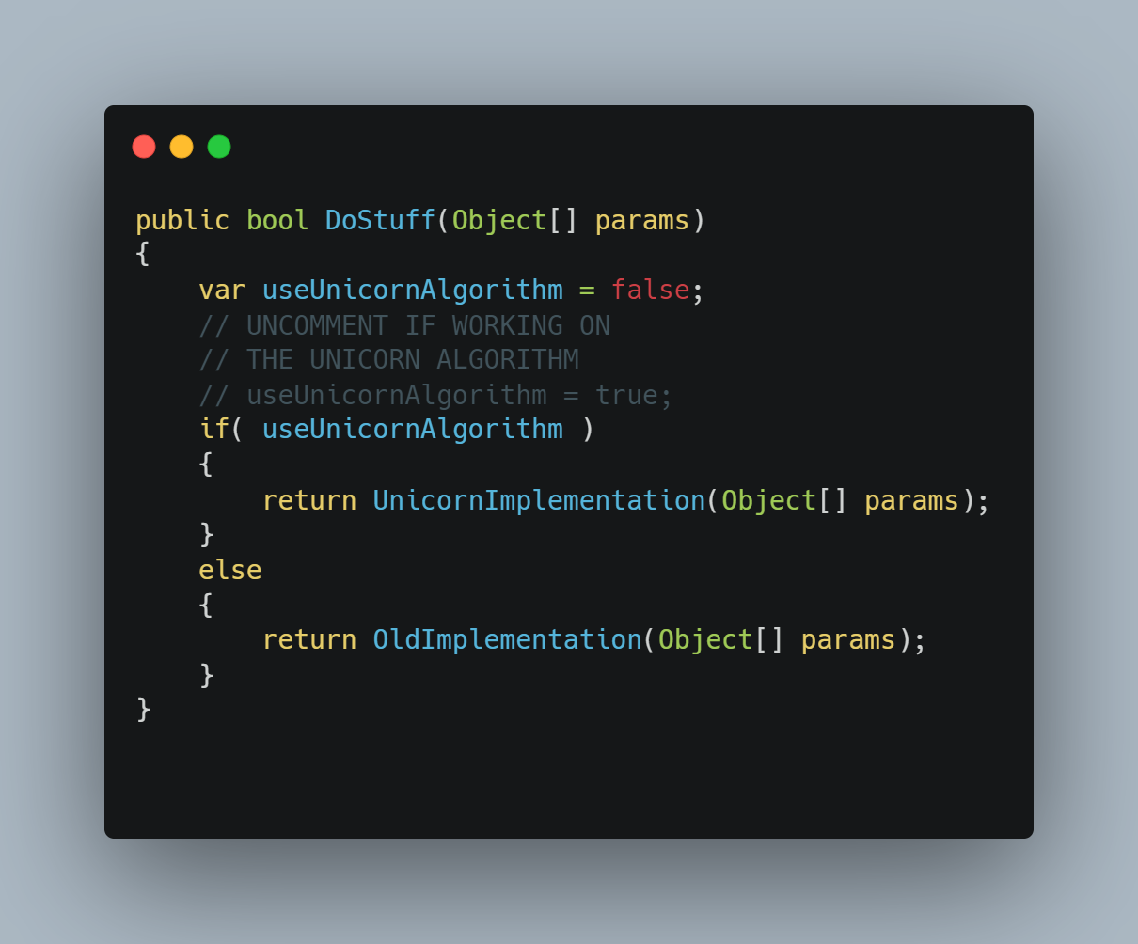
What is it?

Slide 7
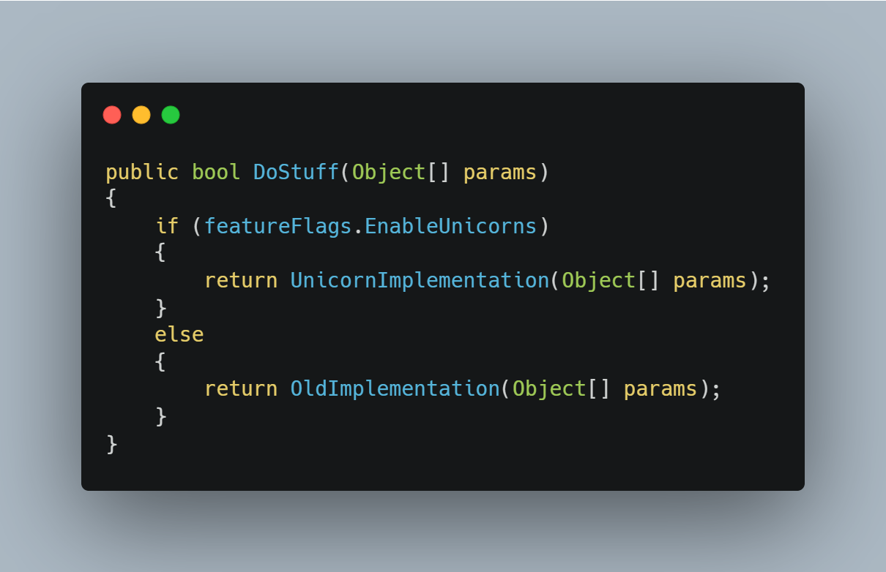
What is it? Feature flags can be simple configuration settings with Boolean values

Slide 8
Why Use Feature Flags?

Slide 9
Feature Flags have different uses
Code separation
Minimize disruption to customers
Progressive rollouts
A/B Testing
Kill switch

Slide 10
Not all Flags are the same Short Term
These are used to roll out new features or conduct experiments.
They can be found anywhere, and can be more complex.
They should be cleaned up after the rollout or experiment.

Slide 11
Not all Flags are the same Long Term
Licensing
Advanced features
Integrations
Operational Flags
Load Management

Slide 12
Deployment vs Release

Slide 13
Deployment vs Release
Deploy
Low Risk, repeatable and routine
Installed on Production
Doesn’t mean features are in use
Release
Higher Risk
Business decision
Enables access to a feature
Allows experimentation

Slide 14
Limit the Blast Radius of Change
Internal Users
Progressive Rollouts
Full Deployment
Canary Testing

Slide 15
Operationalizing Flags

Slide 16
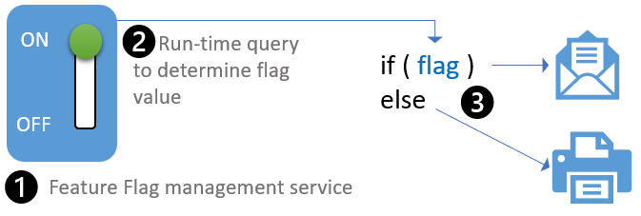
Its all about control
How do you turn it on and off?
Per checkin?
Per server?
Per user?
Dynamically?

Slide 17
Flag Targeting
Targeting Groups
Time
Region
User Details
Percentages
10%/90%
50%/50%
Triggers
Rise in failures
Load

Slide 18
Feature Flag Downsides
Feature Flags are Technical Debt As Soon as You Add Them
As you add flags, it can be harder to support and debug the system.

Slide 19
Flag Best Practices
Have a naming convention for short or long term flags
Use meaningful names with long descriptions
Have a central location for flags, one place to look at available flags
The development team should share flags and configurations at the end of a sprint so that the right configuration is released.
NEVER re-purpose a feature flag

Slide 20
SQL/JSON Models
Be additive, never change existing fields
If you have to remove a field, obsolete it until there is no possibility of rollback

Slide 21

Questions

